Slide 1
NIRS Monitoring in the NICU: 2023 Updates & Education
Matthew W. Harer, MD
Neonatologist

Slide 2
Outline
Sensor Placement
NIRS Monitoring Guideline
What do I need to know?
What do the providers need to know?
NIRS and research

Slide 3
Introduction
Clinical Research Coordinator
Working on Dept of OB and Pediatrics Studies
Significant contributor and expert in NIRS studies
Will see her frequently in NICU and Nursery performing consent, checking on research procedures
Can be a resource for NIRS issues/questions
Phone number: 608-263-7608
Email (if necessary): snschwingle@wisc.edu

Slide 4
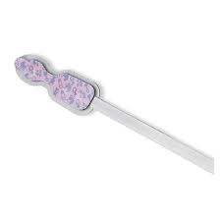
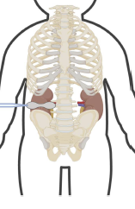
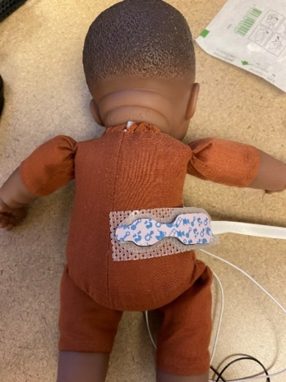
Sensor Placement
Renal
Above the iliac crest and below the last rib in the soft tissue space.
Horizontally placed with light emitting tip closest to the spine but not over the bone. If the light emitting tip is placed on the anterior abdomen or side, it will read intestinal oxygenation.

Slide 5
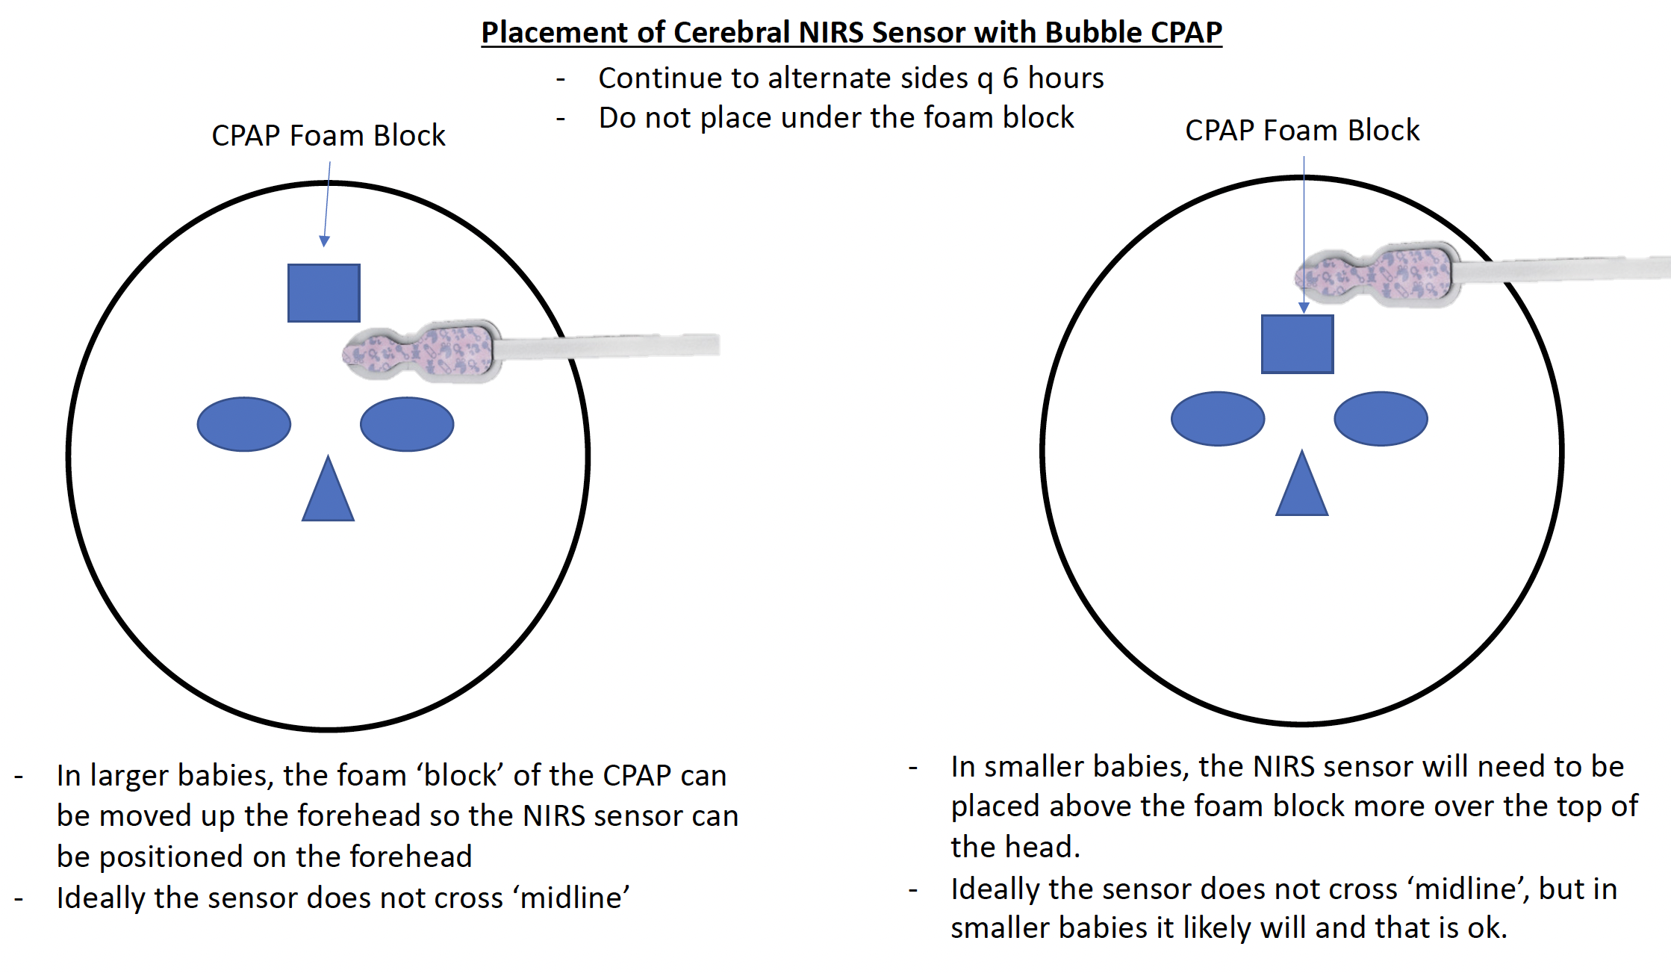
Sensor Placement
Cerebral
Above the eyebrow and below the hairline. Ideally either right or left of midline.
For babies on CPAP – the sensor cannot go directly below the foam – the pressure from the foam could cause skin injury! Consider the following placement:
- Below the foam and above the eyebrow
- Above the foam on top of the hair

Slide 6
NIRS Monitoring Guideline
Approved by Guidelines committee in October of 2022 for both Meriter and AFCH NICU
Begin standard monitoring in a subset of the babies we care for to improve outcomes
Provider ask
Requires specific Epic order for qualifying babies
Requires following algorithm for values outside of normal range
Nursing ask
Application of sensors in babies with an order
Troubleshooting and notifying providers when a value is alarming
Laminated card will be on the machine!
Documentation of NIRS value in chart every 1 hour
Working to have this automatically go into Epic

Slide 8
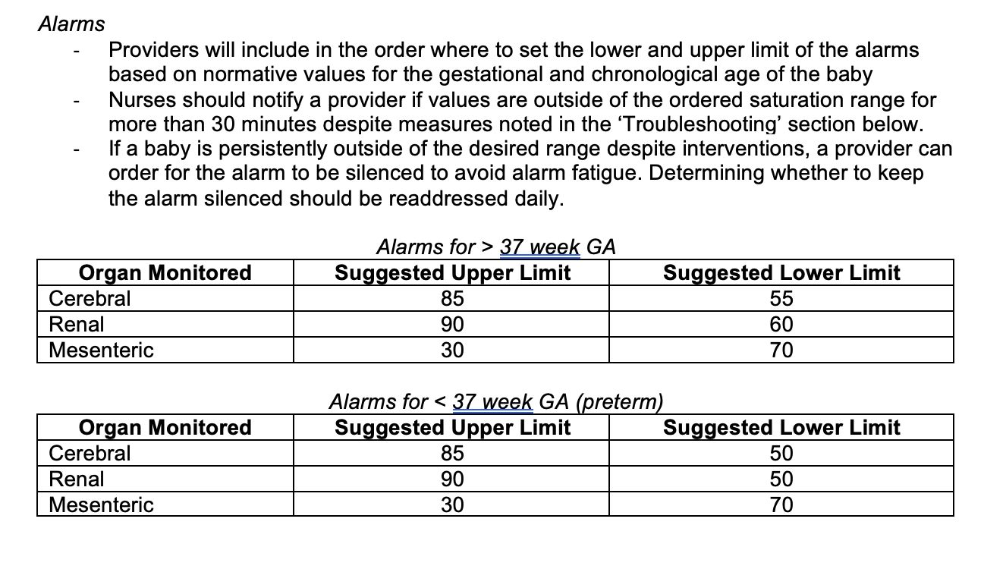

Slide 9
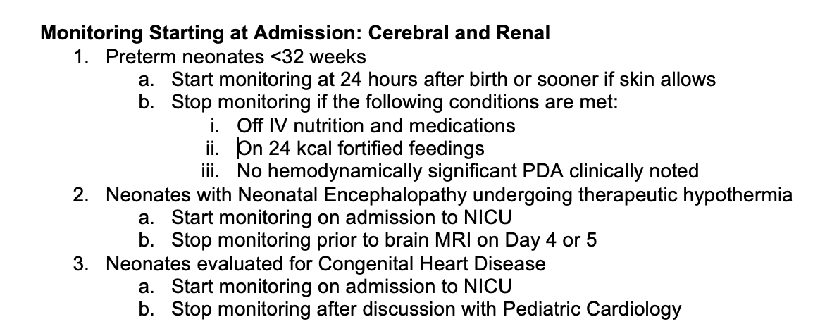

Slide 10
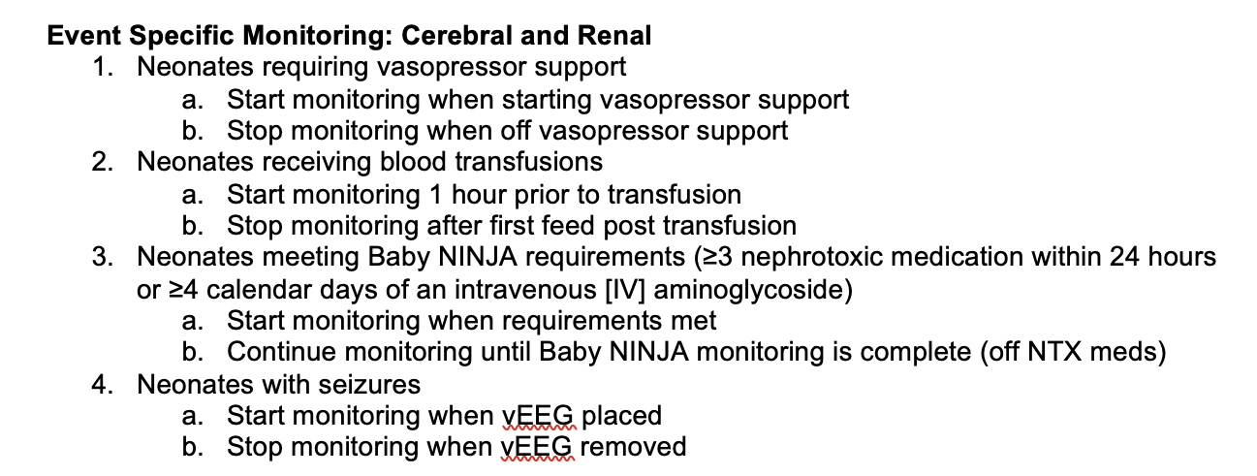

Slide 12
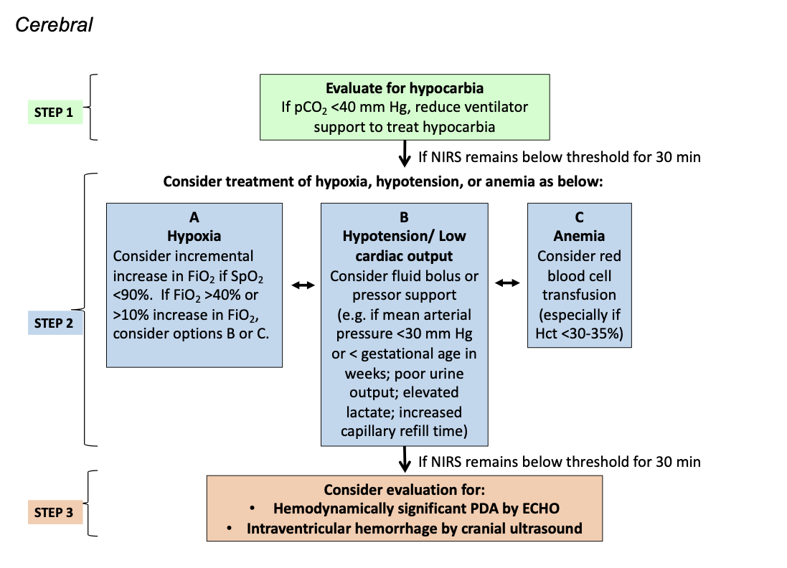
Evaluation and Treatment Guideline

Slide 13
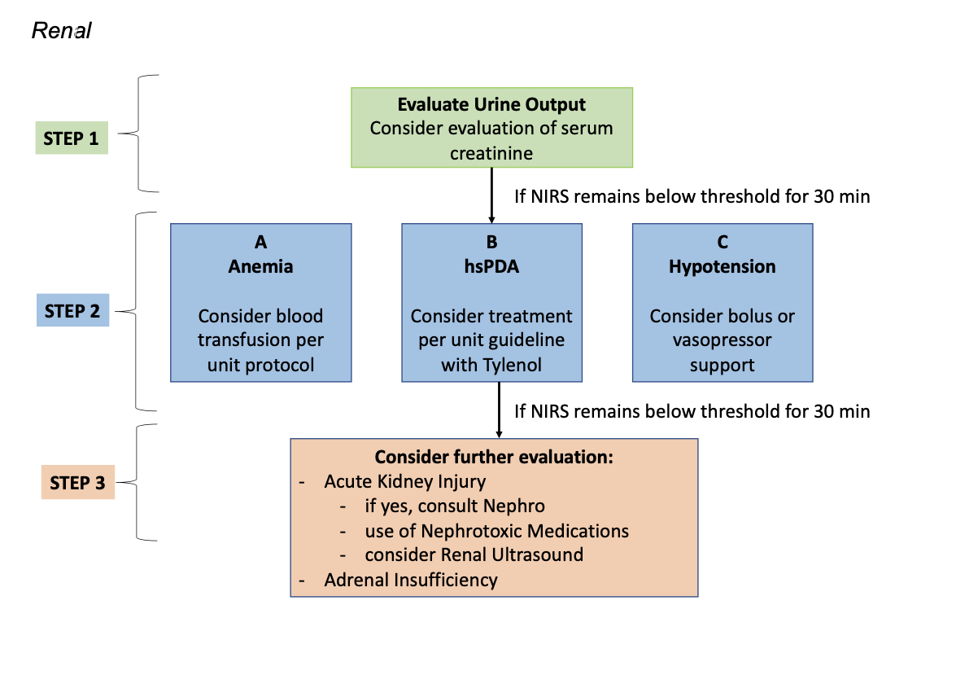
Evaluation and Treatment Guideline

Slide 14
Research and NIRS
Research study will continue
No longer will have ‘blinding screens’
Parents will consent to using the NIRS data instead of applying the sensors
We will continue to do ‘extra things’ for the study protocol – we will notify you!
Continuous monitoring will last until they are removed per the clinical guideline
Bilateral Monitoring of right and left kidney for 3 hours twice in the first 10 days
Kidney US by Dr. Harer between day 7-10
Weekly monitoring for 3 hours until discharge

Slide 15
Take Home Points
Sensor placement is critical, if you have questions, please ask!
Skin Care
<34 weeks – Mepitel and rotate sensors q6 hours
34 weeks or greater – no mepitel, rotate q 24 hours
All babies with NIRS monitoring should have an order placed starting on Feb 1, 2023
All babies on NIRS monitoring will need values documented in NIRS flowsheet every 1 hour
If abnormal value/alarming x 30 minutes, notify provider

